Slide 1
Utah Medicaid Dental Program
Jennifer Strohecker
State Medicaid Director
Director, Division of Integrated Healthcare

Slide 2

Agenda Items
Utah Medicaid background and vision
Current dental coverage
Expansion of dental benefits
Dental policy updates
Overall program updates that intersect with dental services

Slide 3
What is Medicaid?
Medicaid provides comprehensive health coverage to hundreds of thousands of Utahns, including eligible low-income adults, children, pregnant women, elderly adults, and people with disabilities.
Medicaid is administered by states, according to federal requirements.
The program is funded jointly by states and the federal government.

Slide 4
Medicare vs. Medicaid and Duals
Medicare
Medicaid
Duals

Slide 5
Medicaid: A federal/state partnership
Federal Medicaid Assistance Percentage (FMAP)
Centers for Medicare and Medicaid Services (CMS)
State Plan and State Plan Amendment

Slide 6



Utah Medicaid specifics
365,000
members
$5.16 Billion (SFY23) expenditures
348 employees

Slide 7
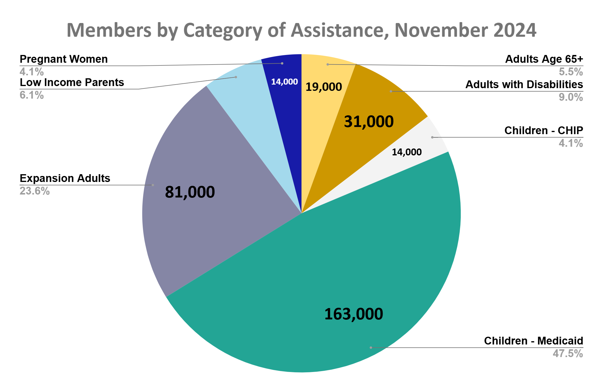
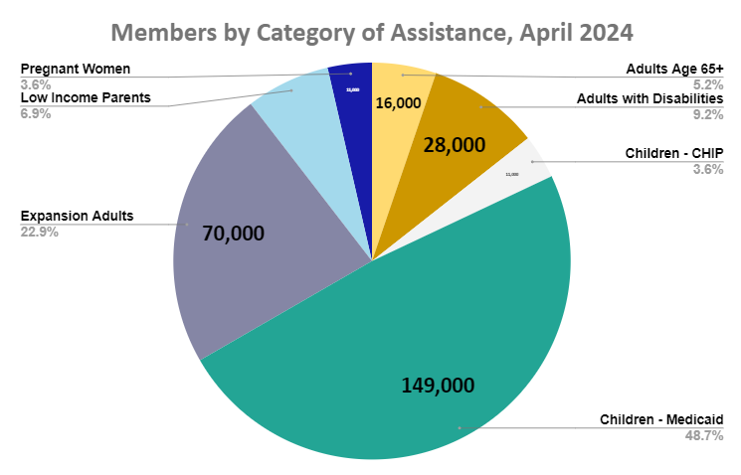

Slide 8




Four Priorities to Guide our Work
Elevate Member Voice
Prioritize Integration
Emphasize Preventative Care
Address Quality of Care

Slide 9
Medicaid is uniquely positioned to meet the oral health needs of low income groups

Slide 10
Low income groups have unmet oral health needs
Both children and adults in low income groups report a higher rate of unmet oral health needs
  25% of children from low-income households
Disproportionately impacts persons of color
Rural individuals report access to care issues
https://www.kff.org/medicaid/issue-brief/variation-in-use-of-dental-services-by-children-and-adults-enrolled-in-medicaid-or-chip/

Slide 11
Medicaid and Dental Coverage
Federal rules require coverage of dental services in some Medicaid enrolled populations, but make dental coverage “optional” in adult populations

Slide 12
Evolution of the Program
First dental program for Adults with Disabilities
Expanded coverage for seniors age 65+
March 2019
1,500 Members
April 2025
100,000 Members
July 2017
45,000 Members
March 2020
10,000 Members
Expanded coverage for TAM members with SUD
New Waiver for Adult Dental Populations

Slide 13
Medicaid and Dental Coverage
Children
Pregnant women
Adults
Mandated groups
Optional groups
Comprehensive coverage policy
Flexible coverage policy

Slide 14
Medicaid and Dental Coverage
Children
Pregnant women
Adults
Run through managed care contracts -
Premier Dental
MCNA
Run through FFS -
UUSOD partnership
Mandated groups
Optional groups
Comprehensive coverage policy
Flexible coverage policy

Slide 15
Managed Care Dental Utilization
Managed Care Enrollment:
As of January 2025 Utah has 158,633 EPSDT and pregnant members enrolled in our Medicaid managed care dental plans and 11,769 members enrolled in our CHIP dental plan.
For FFY 2023 Utah reported:
121,197 EPSDT eligible who received any dental services.
110,799 EPSDT eligible members received preventive dental services
48,889 EPSDT eligible members received treatment services related to dental.
14,346 children received at least one sealant on a permanent tooth.
Post-partum Care:
As of January 1, 2024 enrollees who are eligible for and enrolled in Utah Medicaid or CHIP while pregnant remain eligible for a full Medicaid or CHIP benefit for duration of their pregnancy through the extended 12-month postpartum period.
This benefit includes full dental coverage which means that pregnant members are able to continue their post-partum dental care for a full 12 months following the birth of their child.

Slide 16

Fee for Service Dental Delivery and Utilization
Fee for service dental delivery is a partnership between the Medicaid agency and the University of Utah School of Dentistry (UUSOD)
DHHS:
-Develops Medicaid policy
-Review prior authorizations
-Processes claims / resolves grievances
UUSOD:
-Grows the provider network
-Provides provider supports, listening sessions, educational initiatives
-Serves as a community liaison for providers to DHHS

Slide 17
Fee for Service Dental Delivery and Utilization
During the 2023 General Session of the Utah State Legislature passed Senate Bill 19 “Medicaid Dental Waiver Amendments” was passed and signed into law.
We have received CMS approval and will be offering dental services to 70,000 adult expansion individuals starting April 2025!!!

Slide 18
Expansion of Utah Medicaid Dental Benefits
Effective April 2025, Adults covered by Utah Medicaid will be eligible to receive comprehensive oral healthcare benefits.
  Benefits include:
    Check-ups, x-rays, and cleanings every six months
    Tooth-colored fillings for front teeth
    Silver and tooth-colored fillings for back teeth
    Root canal treatment for certain teeth
    Tooth extractions
    Dentures or partial dentures
    Emergency exams for sudden and severe tooth pain
    Crowns (porcelain and porcelain-to-metal crowns)

Slide 19
Expansion of Utah Medicaid Dental Benefits
During the 2023 General Session of the Utah State Legislature passed Senate Bill 19 “Medicaid Dental Waiver Amendments” was passed and signed into law.
This legislation requires the Utah Department of Health and Human Services to seek 1115 Demonstration waiver approval from the Centers for Medicare and Medicaid Services to provide dental services to Medicaid-eligible adults aged 21 and older who are not already eligible for dental services.

Slide 20
Medicaid Dental Policy Updates - January 2025
Raised rates for D9223 (anesthesia)
Opened D4910 (periodontal maintenance)
Opened Alveoloplasty and Vestibuloplasty
Opened D9410 (dental care in extended care facilities)
“Medicaid regularly evaluates program coverage and reimbursement policy to ensure it meets the needs of Medicaid members.”
Notes:
A fee schedule increase for dental anesthesia code D9223 (deep sedation/general anesthesia - each subsequent 15 minute increment). We increased the fee schedule from $58.99 to 96.10.
We opened D4910 (Periodontal maintenance) for members who have periodontal disease
We opened Alveoplasty and Vestibuloplasty codes to help create a better fit for dental prosthetics (dentures)
We opened D9410 (house/extended care) so providers can bill when they see patients in Nursing facilities when patients are unable to travel to a dental office.

Slide 21
Enrollment and Eligibility Changes
-January 2024
12 months continuous enrollment for children
12 months continuous postpartum coverage

Slide 22

Medicaid serves individuals who experience incarceration

Slide 23
Medicaid Coverage for the Justice-Involved
Incarcerated individuals have higher rates of mental health, substance use disorder, and physical health conditions.
Healthcare delivery in carceral setting is challenging and may not build a successful bridge of treatment to transition back to the community.
6x
Higher rate of mental illness
2021 Legislative Audit of State Prisons: Inadequate care provided
49%
Receive inadequate SUD treatment
Notes:
Sources:
[1] Utah Commission on Criminal and Juvenile Justice. Mentally Ill Offender Initiative, September 2008
[2] Office of the Legislative Auditor General, An In-Depth Follow-Up of Healthcare in State Prisons, April 2023
[3] Peterson, B., Nystrom, S. and Weyland, D. Utah Justice Reinvestment Initiative 2017 Annual Report, October 2017

Slide 24
Re-entry Justice Benefit (Adults)
Medicaid eligibility screening upon intake
Up to 90 days pre-release, the member becomes eligible for an “outpatient benefit package” and that can be billed to Medicaid, including:
  Physical health
  Behavioral health
  Oral health
  Medications
Comprehensive case management through re-entry
Screening for housing (HRSS / rental assistance)
Upon release, the individual leaves with at least a 30-day supply of medications and has a warm handoff to community providers (case managers)

Slide 25

Early and Periodic Screening, Diagnostic, and Treatment (EPSDT) Program

Slide 26
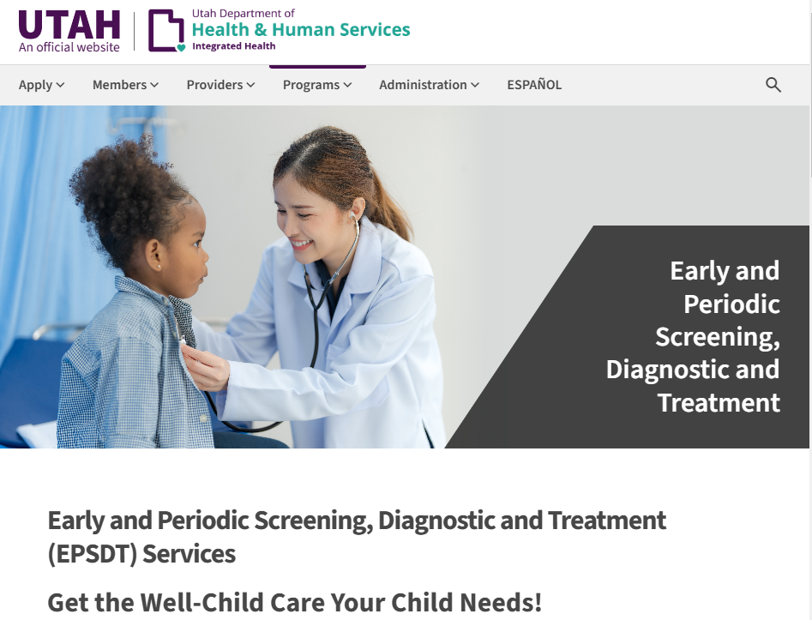
EPSDT Resources and Website
This benefit is for all children up to the age of 21.
This is an expanded benefit offered to children based on “medical necessity”.
The Medicaid website and manual have more information and a pathway to request an EPSDT service.

Slide 27
Billing and Reimbursement
In April 2023, Utah Medicaid launched a new billing system called Provider Reimbursement System for Medicaid (PRISM)
  Medicaid enrolled providers are able to file claims directly with Utah Medicaid and receive reimbursement within 2-3 weeks
    No patient payment collection
  Utah Medicaid has worked tirelessly over the past year to work through all the hurdles and challenges that come with launching a new system
  Dedicated Utah Medicaid staff are available to provide training and support for providers (and other applicable staff) to become Medicaid enrolled, submit claims and prior authorizations, and navigate PRISM
  Training resources for PRISM can be found at the following website: medicaid.utah.gov/prism/

Slide 28
How to Become a Medicaid Enrolled Provider
For more detailed information and training, please visit: https://medicaid.utah.gov/become-medicaid-provider/
Submit Application in PRISM
Create a Utah ID Account
Notes:
What does it take to be an affiliated provider with UUSOD ?
Complete a questionnaire that obtains basic information like NPI number and then sign an agreement

Slide 29
How to Become a UUSOD Associated Provider
Enroll with Utah Medicaid
  https://prism.health.utah.gov
Apply to be an associated provider with UUSOD
  https://physicians.utah.edu/dentistry-medicaid
  801-213-7495
Stay informed by signing up for Medicaid Information Bulletins and UUSOD newsletters

Slide 30
Questions?

